Slide 1


Slide 2

Your Heading
Can Go Here
Key Highlights
July 2024 – June 2025
Leading:
Cobden NPS developed
Long Term Plan submission completed
Region Wide Spaces and Places review facilitated in partnership with GDC and stakeholders
West Coast Emergency management collaboration
Facilitation and activation of PARS strategy recommendations
  Coordination of Westland Rec Centre Users Group
  Facilitation of shared spaces for Football
  Facilitation of a collaborative submission to LTP
Supported planning of Annual West Coast Sports Awards

Slide 3
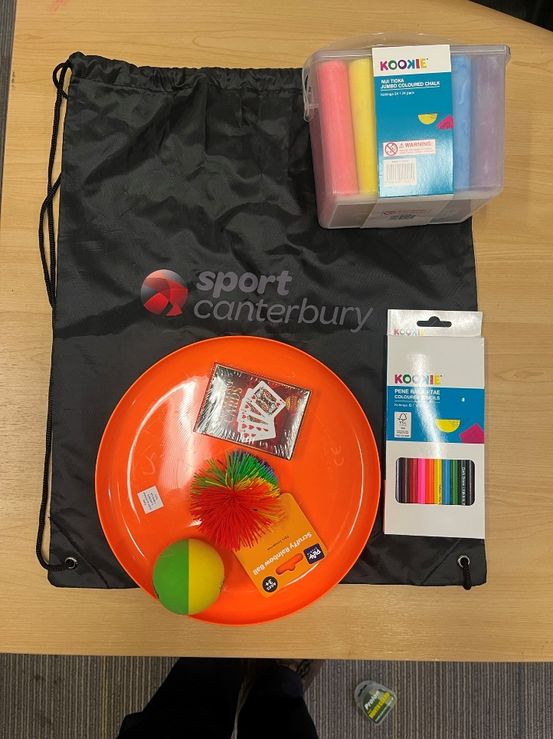
Your Heading
Can Go Here

Slide 4
Your Heading
Can Go Here
Key Highlights
July 2024 – June 2025
Strengthening and Enabling:
Facilitated Coach Development workshops alongside secondary schools and community organisations
Capability build of sector leads
Delivered Physical Activity Leaders Programme in Primary Schools
Strength and Balance Programme partnerships

Slide 5
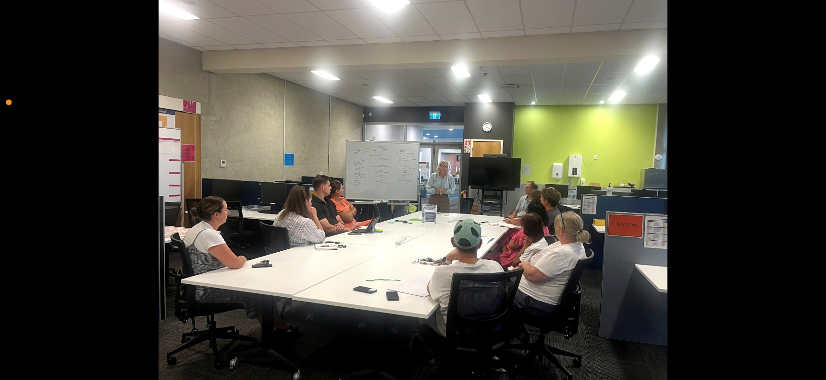
Your Heading
Can Go Here

Slide 6
Your Heading
Can Go Here
Key Highlights
July 2024 – June 2025
Providing and Delivering:
TMAA funding 2024/25
  $136,608
  15 organisations
Festival days and coordination support
Cobden Neighbourhood Play System report advocacy/activations
  Beach access project
  Richmond Street Playground upgrade
  Water safety surf lifesaving school support
  Footpath enhancement

Slide 7
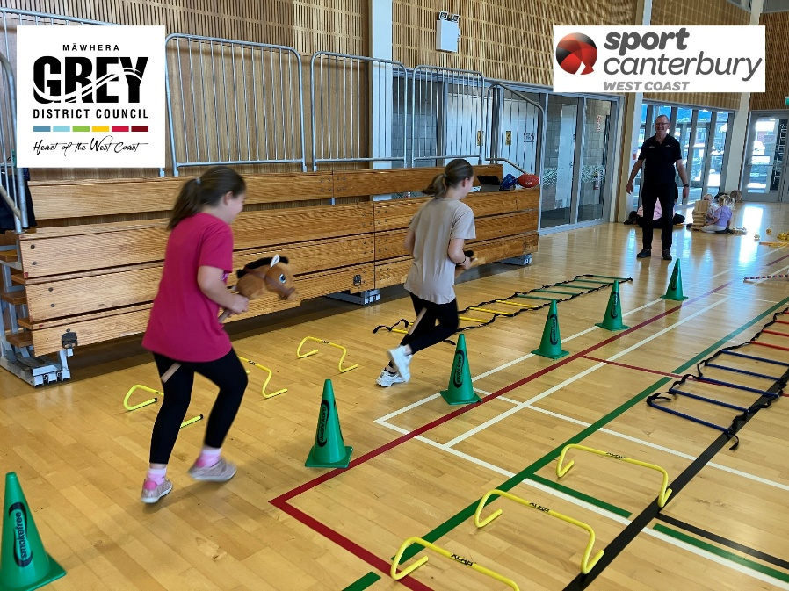
Your Heading
Can Go Here

Slide 8
Your Heading
Can Go Here
Impacts
July 2024-June 2025
Cobden NPS
Review of playgrounds has empowered Cobden Community Group to explore funding partnerships to enhance existing facilities.
Development and roll out of Wayfinding project
Stencils within the school will provide diversified play opportunities for tamariki.
Cobden Community Group Submission to Council LTP 2025-34 informed by findings from NPS, particularly around infrastructure such as footpaths
Opportunity to explore temporary pilot to reopen school gates outside of school hours as a result of work done in partnership with Cobden Community Group

Slide 9
Your Heading
Can Go Here
Impact
Kia ora All,
I really appreciate your acknowledgment that reopening the school grounds hinges on our ability to protect and maintain the space.
I also want to mihi to you and the Cobden Community Group for the sheer scale of mahi already underway. That list of initiatives is incredibly impressive and speaks volumes about the momentum that’s building within the hapori. From the Richmond Street upgrade to the Way-finding project, and the wider aspirations around housing, play, and safety—it’s clear there’s a lot of positive change happening, and Cobden is really lifting.
Ngā mihi nui
Noula Markham
Tumuaki
Cobden School

Slide 10
Your Heading
Can Go Here
Sector Updates
Rapid Review
Active All Year Round
Budget 2025
Youth offending pilots

Slide 11
