Slide 1
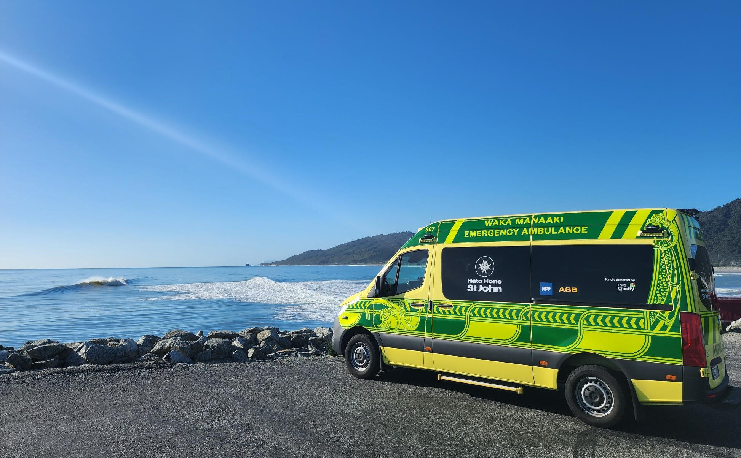

Hato Hone St John
West Coast

Slide 2

Who are we?
International organisation, founded in New Zealand in 1885
Leading ambulance provider
Community Health programmes
Charitable organisation
Our kaupapa or purpose is ‘to make
life-changing differences with our communities.’
Notes:
- We deliver life-changing health
and wellbeing services that
build resilience and strength
in our communities.

Slide 3

Greymouth Ambulance Operations
9 paid staff (FTE)
10 volunteers
Vehicles –
  1x 24/7 paid ambulance
  2 x First Response Units that are run by volunteers, based in Greymouth and Blackball
1800 Emergency Calls in past 12 months
Approximately 1.5% of those were Purple (Cardiac Arrest)
Approximately 30.8% were Red – considered to be life threatening
Notes:
- What St John are most well-known for within the public
- We service 90% of NZ population with ambulance services, and 97% of NZs geographical area.
-We also coordinate clinical staff on rescue helicopters and have Mass Casualty Incident Capabilities. Some rural areas have 4WD response units.

Slide 4

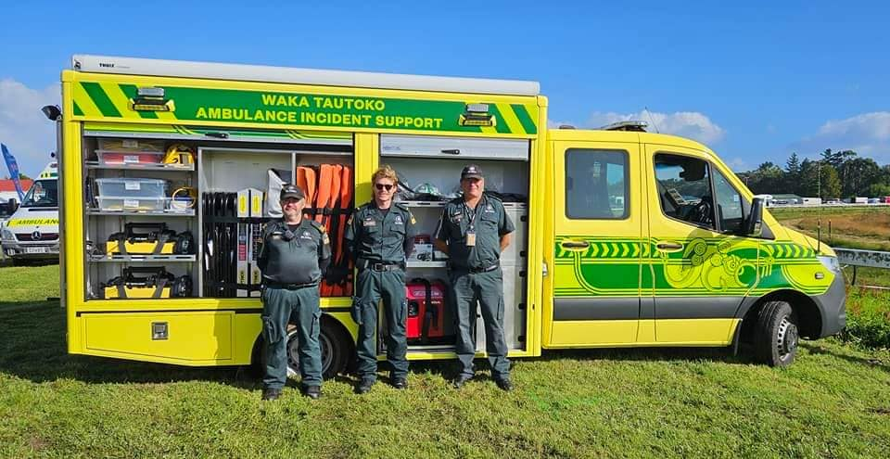
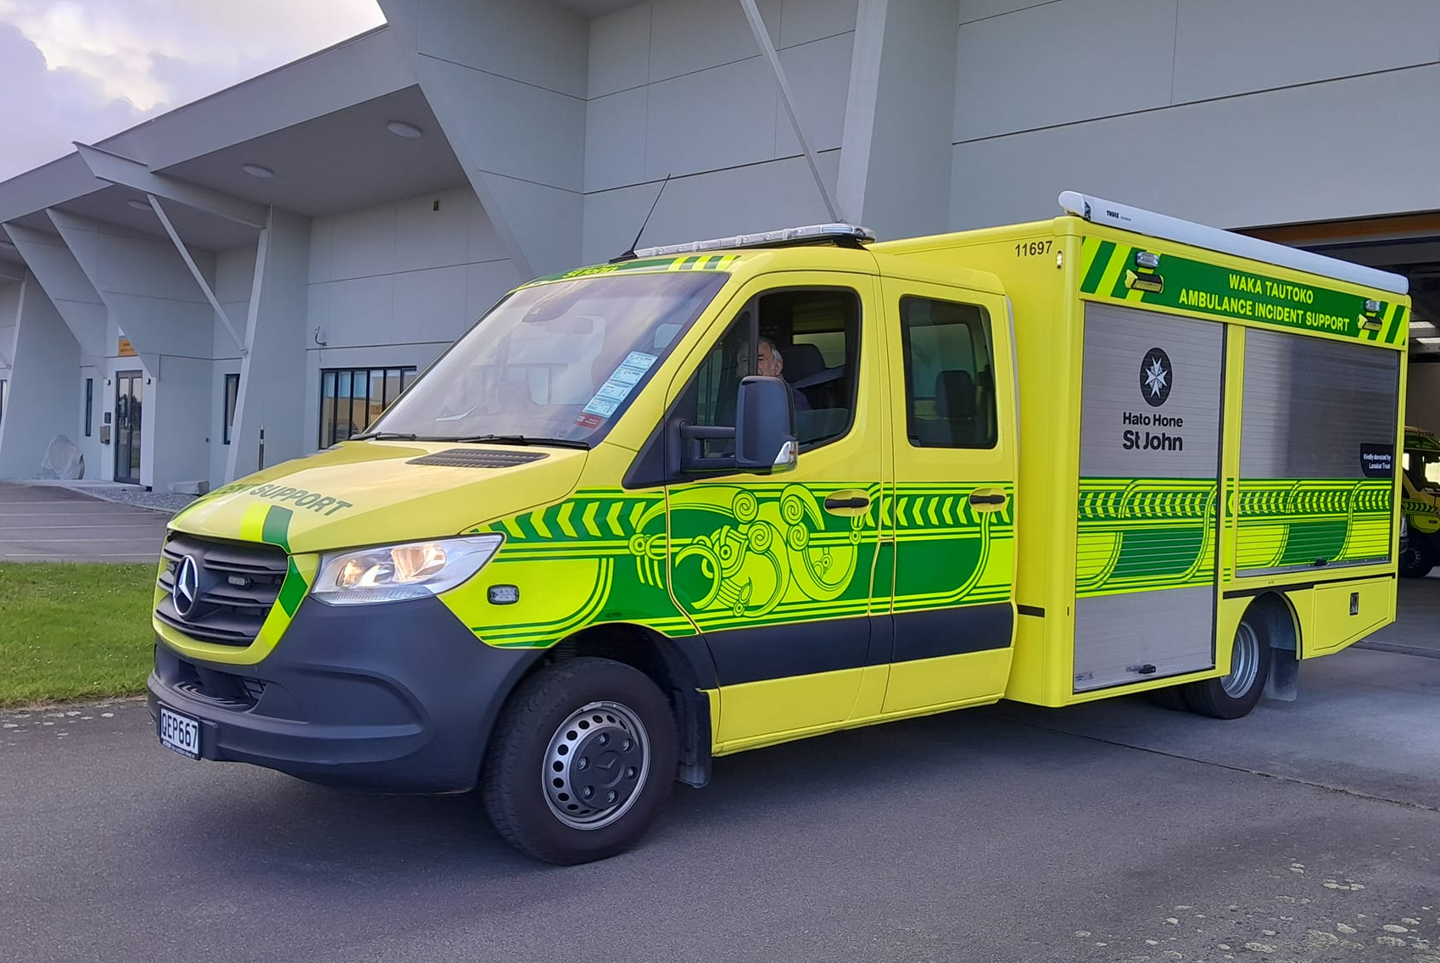
Major Incident Support Team (MIST)
MIST plays a crucial role in supporting Operations and strengthening our response capabilities during major incidents and large events.
The MIST vehicle was donated to the West Coast by donors from Auckland.
Vehicle is based in Greymouth and run by volunteers.
Notes:
- This used to be called the supports scheme
- Covers medical emergencies, not accidents covered by ACC
- This does not cover PTS.
-This means if you need us in a medical emergency, we can be there for you – free of charge.

Slide 5
Area Committees
Local groups of volunteers who plan and fund programmes and initiatives to ensure our communities are stronger, healthier and more resilient.
West Coast Area Committee is made up of
eight volunteers.
Partner with other organisations and networks to support community health needs.
Notes:
-The role of area committees is to build stronger, healthier, and more resilient
communities.
-Developing and maintaining strong relationships in the community is critical, ensuring others have a
good awareness of what activities Hato Hone St John is doing locally.
-Identifies community health needs.
-Support local members, fundraising, and property needs.

Slide 6
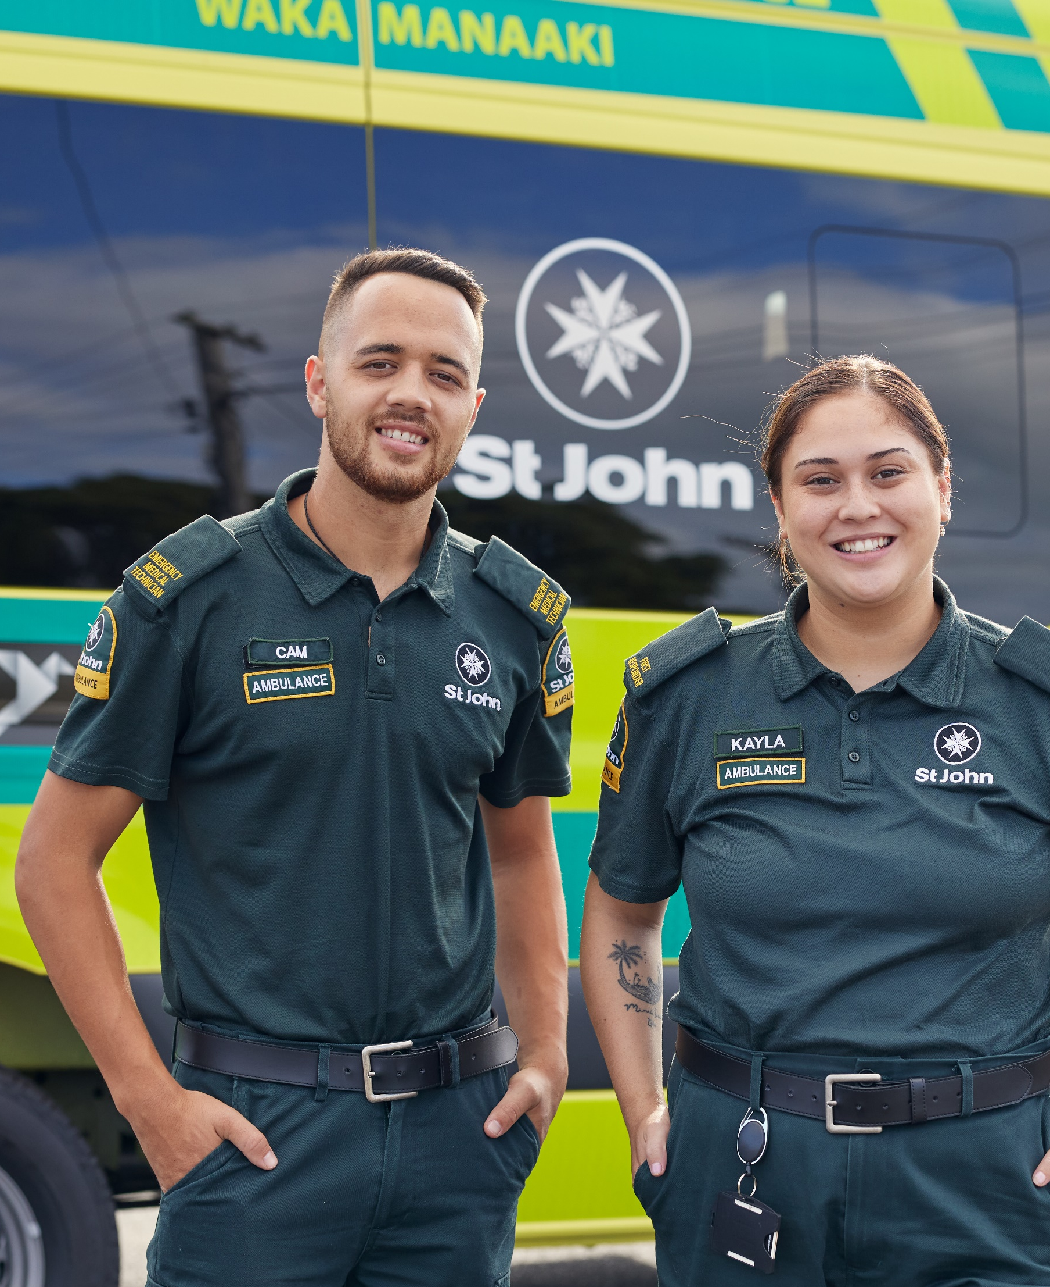
Ambulance Membership
Covers the cost of ambulance call outs for medical emergencies.
Annual membership fee
    Individual - $55
    Joint - $75
    Household (covers 3+ people at same address) - $90
Notes:
- This used to be called the supports scheme
- Covers medical emergencies, not accidents covered by ACC
- This does not cover PTS.
-This means if you need us in a medical emergency, we can be there for you – free of charge.

Slide 7
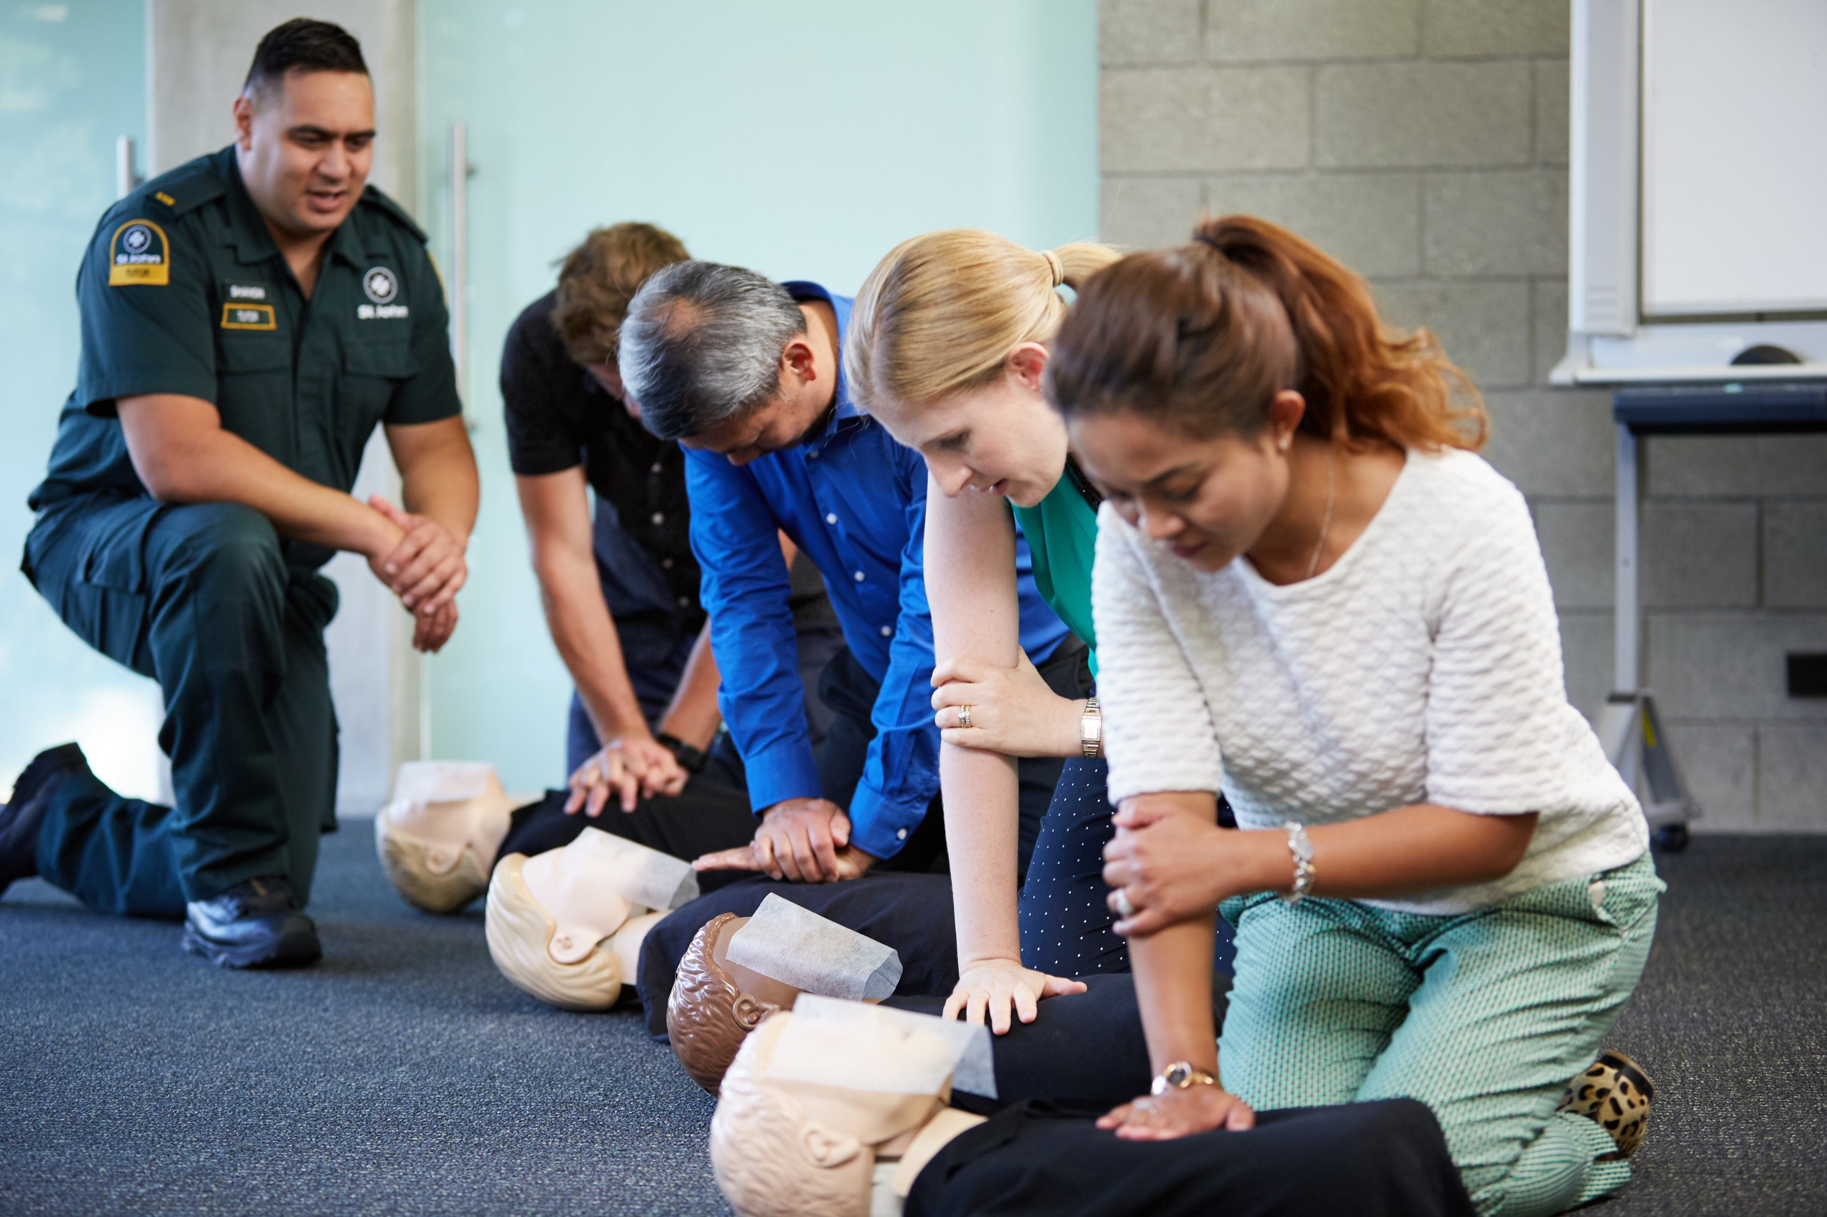
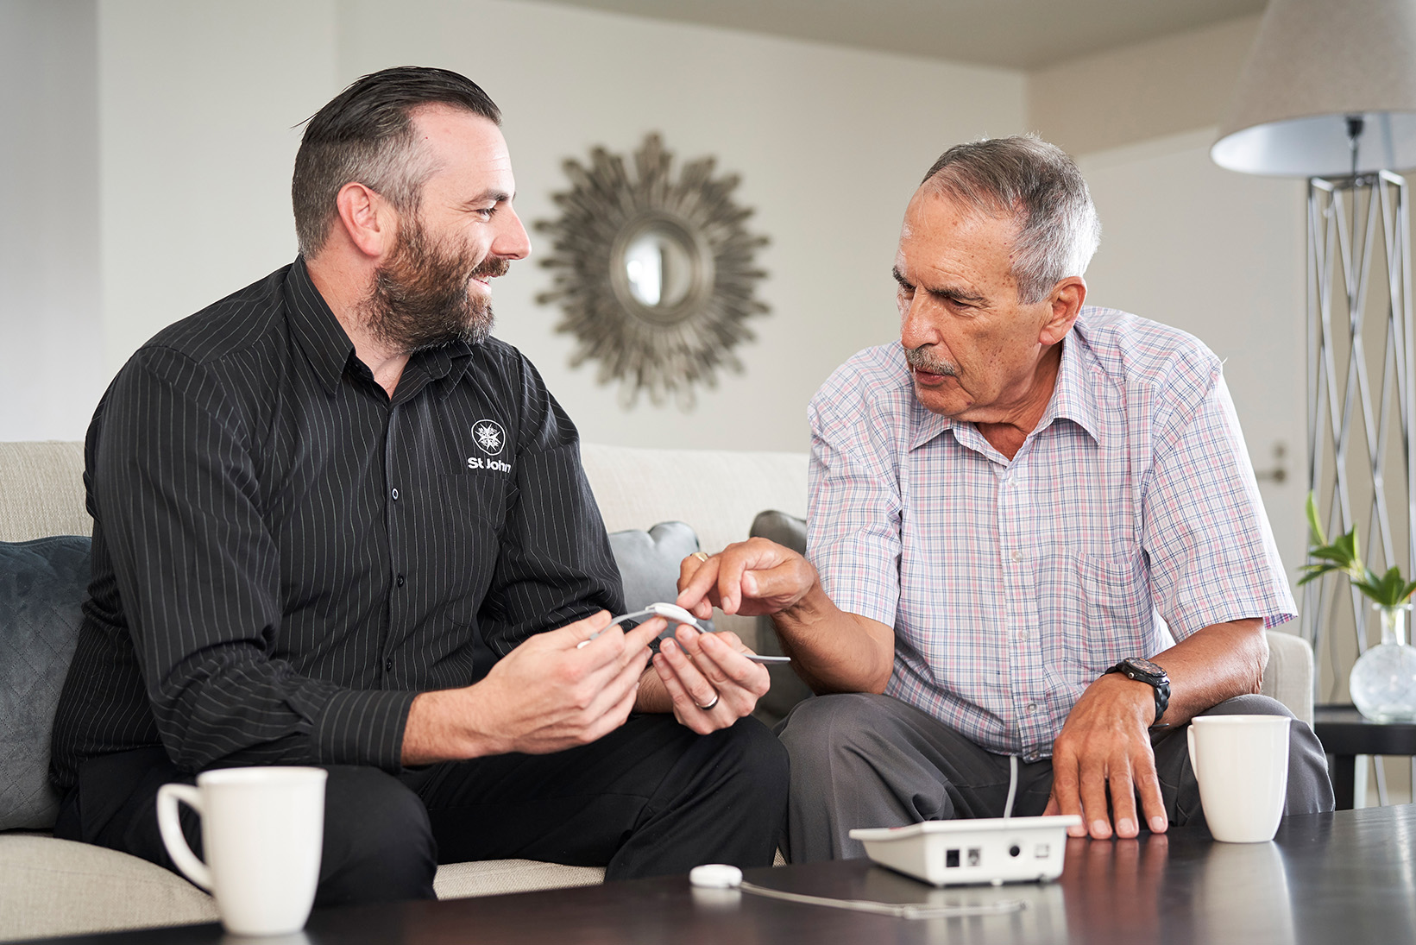
First Aid Training
St John First Aid training offers a wide variety of course options including Mental Health first aid.
Medical Alarms
Hato Hone St John medical alarms are the only alarms to direct users straight to our 111call centre.
Alarms for home and away to enable independence and peace of mind.
Self-referred or referred through GP
Notes:
-Currently have 14,000 medical alarms in the South island
-Last year there were 15,696 alarm activations with 7,057 ambulances attenidng an activation
-Great way to keep someone independent in their own home, while having the peace of mind that help is on its way easily if requried.
-We are an accrediated provider in NZ and government subsidies are avaliable for a specific cohort of clients

Slide 8
Waka Ora Health Shuttle
Provides koha-based transport to health and wellbeing appointments.
Operated by eight trained volunteers.
Transported clients on 728 individual trips and travelled 19,803 kms since June 2024.
Supports timely access to health services and increases opportunity for independent living.
Currently trialing a wheelchair hoist
Covers satellite towns including Ikamatua, Dobson, Stillwater, Runanga, Dunnollie and Blackball.
Notes:
- (a koha is appreciated).
- Funded by clients, donations, grants and fundraising events.
Provides a valuable service for those in the community who would otherwise struggle to get to well-being appointments
Provide the opportunity for service users’ health to be better maintained or improved by attendance at regular appointments
Provide a social environment where frequent users of the service can be supported to engage with like-minded members of the public, preventing social isolation.
- Appointments can be ;
Doctors
Dentists
Addiction Service
Mental Health services

Slide 9
Youth Programmes
For Year 1 – Year 13 students
Offers a wide range of opportunities to
  Learn first aid
  Develop leadership and confidence
  Promotes a healthy, caring attitude to their community and environment
Greymouth Youth Division has 32 Penguins and 14 Cadets
Aotearoa (on-line) Division is supported by the West Coast leadership team
Notes:
Only $25 a term
There are ___ divisions in the ___ district (Fill in the underline dash area with your info).
Any local information like badges, Grand Prior, Camps etc

Slide 10
Community Care
Friends of the Hospital
Four volunteers provide comfort and support to patients, family and friends in Te Nikau hospital – started in 2020
Caring Callers
One volunteer provides a telephone friendship service for clients who are isolated or feel alone.

Slide 11
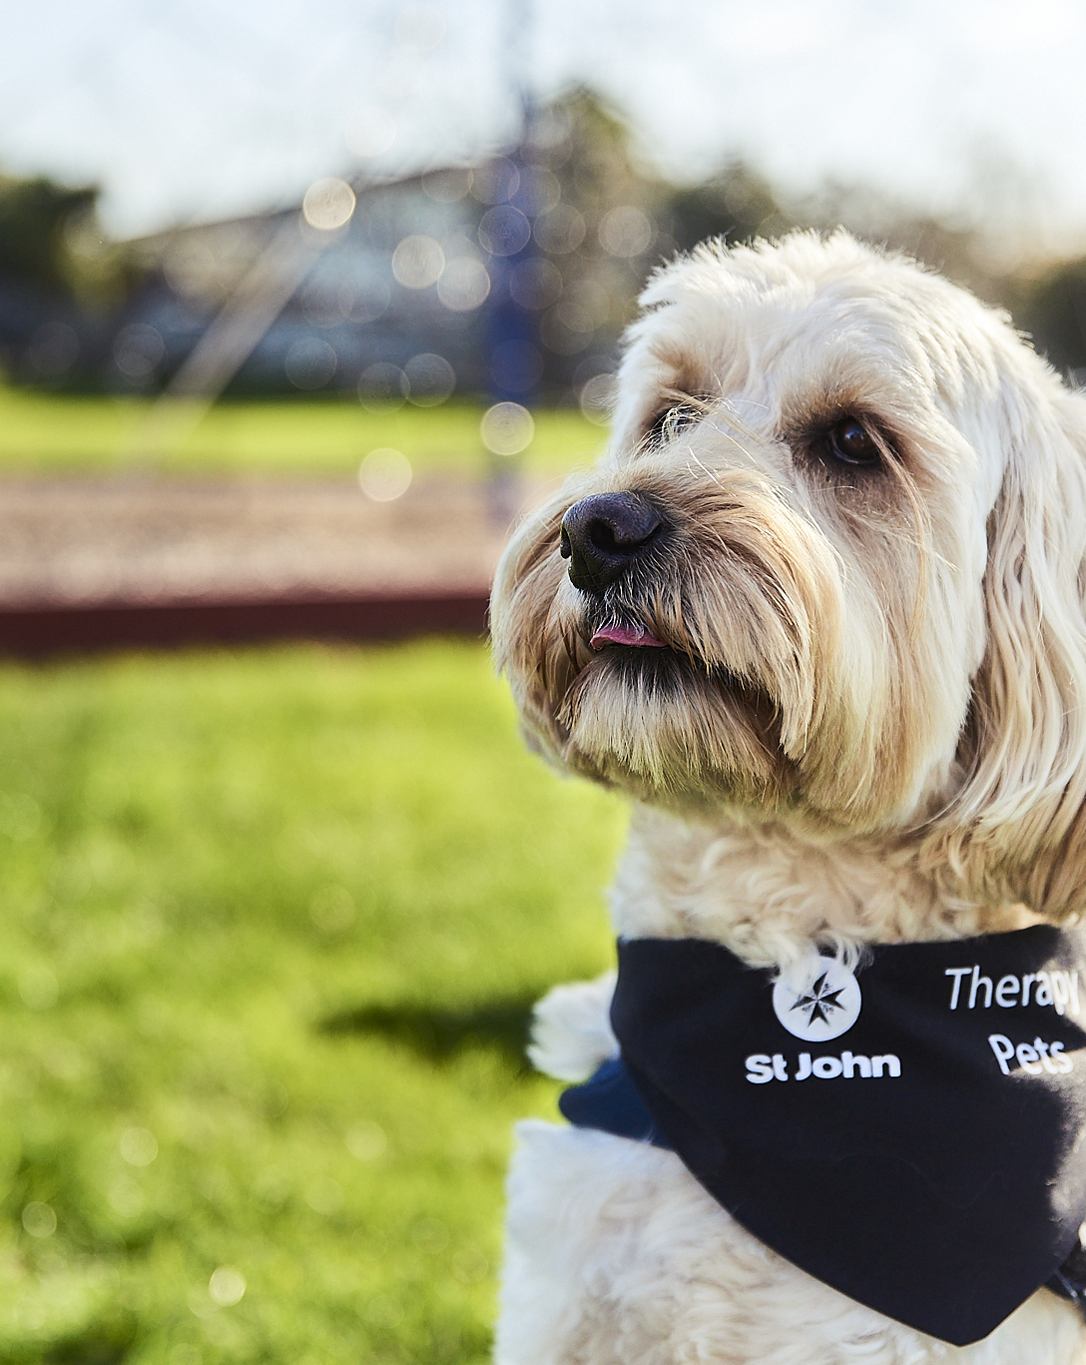
Therapy Pets
Five volunteers and their pets visit rest homes, assisted living facilities, hospitals, schools, and other community groups.
The pets can help
    boost wellbeing
    ease loneliness
    provide distraction and comfort
    offering chats, pats and smiles!
Notes:
These furry friends can help children with their reading by providing wellbeing, ease loneliness, and provide distraction and comfort.

Slide 12

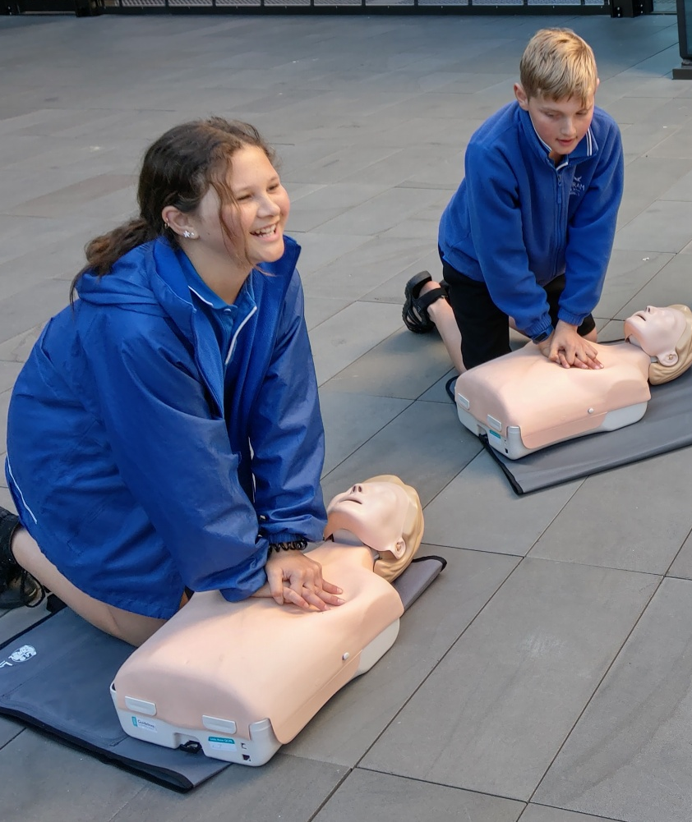
Community Education
St John in Schools
Teaching tamariki the skills to act in an emergency and to keep themselves and others safe.
Mums and Bubs
Initiative offering free workshops teaching caregivers how to do CPR and what to do if an infant chokes.
Course is run by a Paramedic that volunteers his time to the Mums and Bubs programme
Notes:
Early Childhood Education ECE Modules
ECE modules to pre-school age children in short, fun and interactive sessions.
Teaching our Emergency Aware module which familiarises children with the role of emergency services in their community, or our Safety Aware module which focuses on keeping ourselves and others safe
Poipoia Te Pitomata - Harnessing Potential
A programme co-designed and delivered in partnership with youth organisations, schools, iwi/hapū and marae for young people aged 14-25 years.
This programme is about harnessing the potential of our young people by nurturing them to grow as future first-aiders and leaders in their communities.
Poipoi means to nurture and grow, and the kaupapa of this programme is about harnessing the potential of rangatahi (young people) through nurturing them to improve their confidence and to contemplate their futures. It gives participants knowledge and skills in leadership, first aid, and wellbeing.
St John in Schools
Delivers interactive sessions to children from preschool up to Years 9 & 10, empowering them to act in an emergency (including CPR), and keep themselves and others safe.
We have 28 Community Educators around Aotearoa.
Whātuia te Waiora Weaving Wellbeing

Slide 13
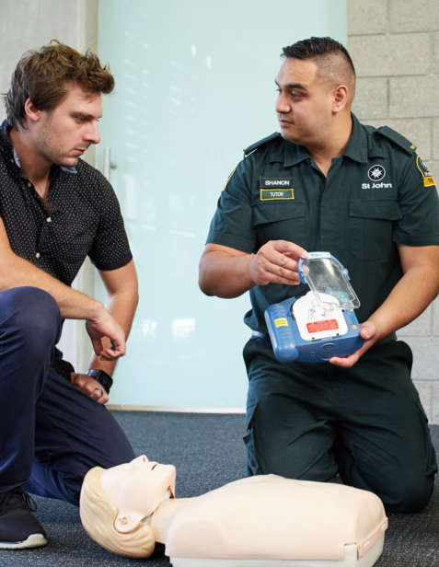
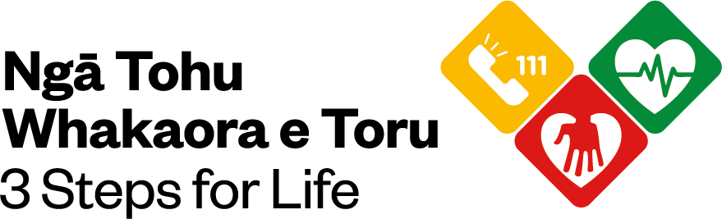
3 Steps for Life
296 Trained in the Grey District in the past 12 months.
Build confidence and lifesaving skills.
Learn how to save a life in the event of a cardiac arrest.
Free, one-hour session for groups.
1. Call 111
2. Start CPR
3. Use an AED
Notes:
People can become educators.
This is a volunteer role
Free, free, free!

Slide 14
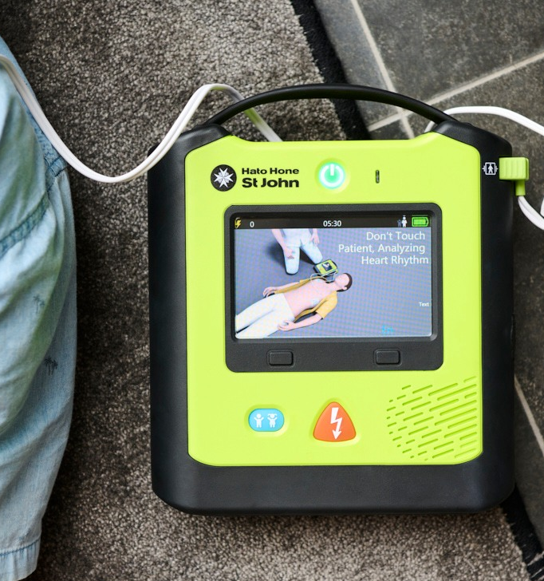
Medical Products AEDs
We sell a wide range of first aid essentials – from first aid kits, refill packs and medical supplies to defibrillators.
Shop online today to make sure you are prepared for a medical emergency.
buy.stjohn.org.nz

Slide 15

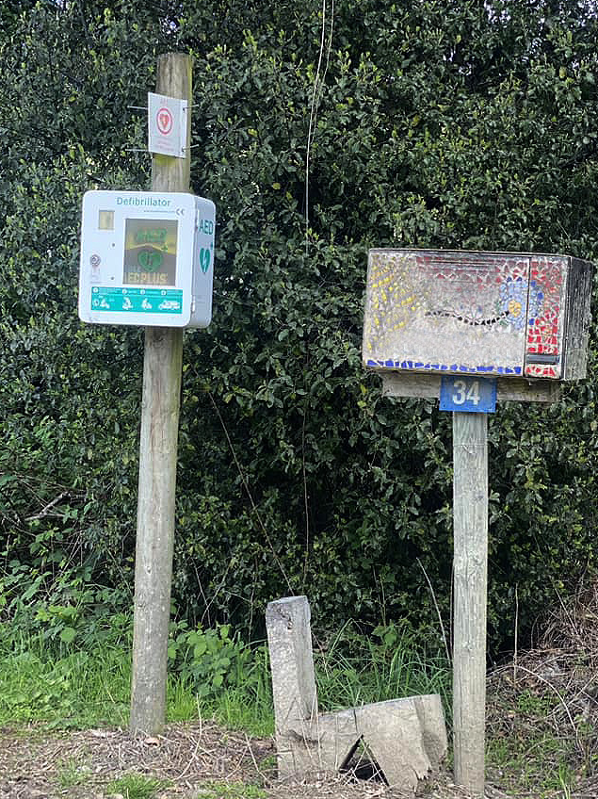
To support better cardiac arrest survival rates, Hato Hone
St John in Greymouth has launched its “Check your AED and save lives” campaign.
The campaign aims to encourage AED owners to regularly check and maintain their AED so that if they are needed in an emergency, our 111 call handlers can direct a first responder, GoodSAM or bystander to the AED, confident that it is fully operational.
To support this strategy, Hato Hone St John offers free
3 Steps for Life sessions to help increase awareness of cardiac arrest and give people of all ages the confidence to perform
CPR and use a defibrillator to help save a life.

Slide 16
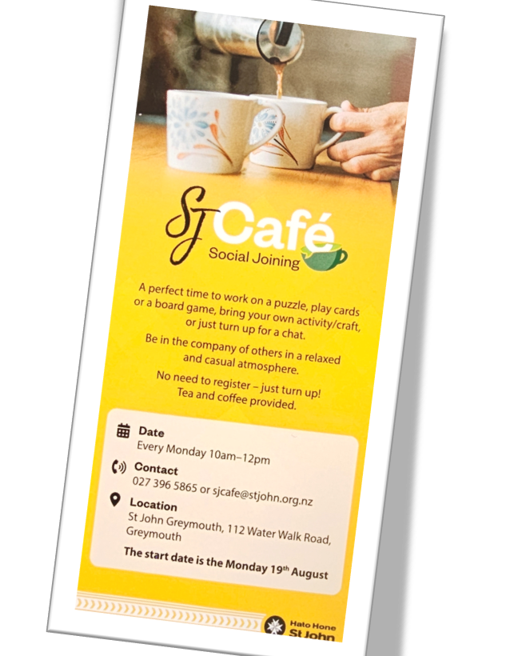
SJ (Social Joining) Cāfe
The Social Café offers people the opportunity to connect with others on a weekly basis over morning tea, games, crafts or just a good chat.
The Greymouth SJ Café opened in August 2024 and now has 10 – 20 regular attendees.
The Café is open every Monday,10am to12noon, except on public holidays.
SJ Cafés are run by Hato Hone St John volunteers and a Te Whatu Ora Health Improvement Practitioner (HIP)
“The impact of social isolation on society is something we hear about every week with bad news about the harmful effects that a lack of
social connection has in our schools, workplaces, and communities,”
Notes:
These furry friends can help children with their reading by providing wellbeing, ease loneliness, and provide distraction and comfort.

Slide 17
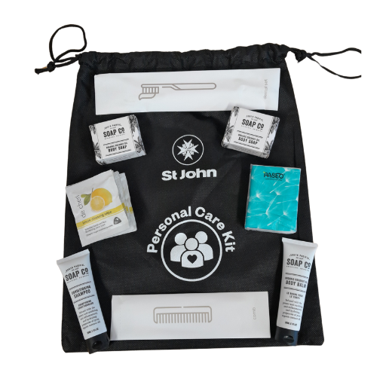
Personal Care Kits
For Ambulance personnel and other staff to distribute to people without personal care items due to emergencies or other circumstances.
The kits provide a local solution to basic hygiene for people in need, including patients who are transported to hospital unprepared.
They can also be offered to community centres and medical centre for their emergency cupboards.

Slide 18
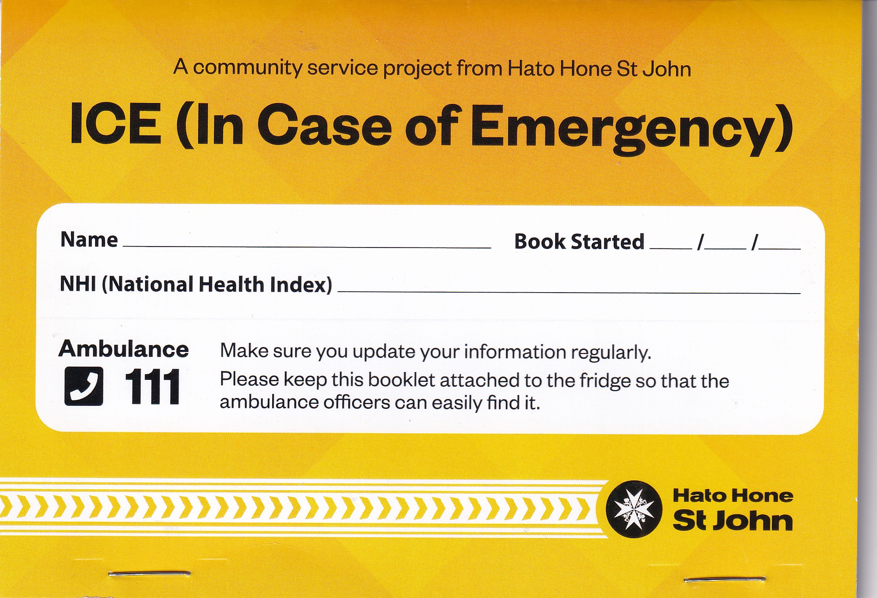
In Case of an Emergency Booklets (I.C.E Books)
The booklet is handed out to people to record their personal and medical information so that is ready for use in the event of an emergency.
The booklet comes in a plastic sleeve with
a magnetic strip attached so it can be
stuck to the front of the fridge

Slide 19
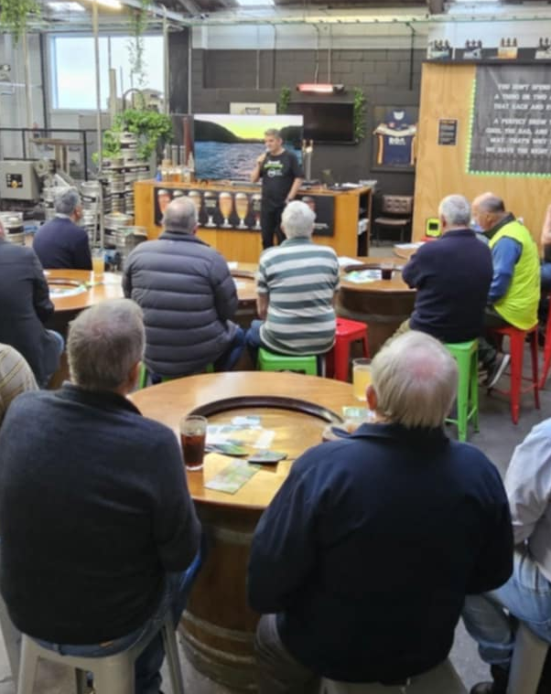
Men’s Health Nights
Provide information specifically for men in a comfortable and safe space.
Guest speakers include GP’s, mental health nurse, counsellor, and a fitness and nutritional expert.
Provide awareness and information to men, about their health and mental wellbeing
Encourage men to have regular health checks and seek advice.
Help men to stay healthy and well before they become seriously ill.
Notes:
People can become educators.
This is a volunteer role
Free, free, free!

Slide 20
Local Funding and Support
The West Coast Area Committee does not receive government funding to deliver our community health services and initiatives.
We rely on donations, generous bequests and grants to support our work.
Other income streams include Annual Appeal, raffles, spare change programme, first aid kit sales and partnering with community organisations to raise funds.
We are very grateful for the continued support of the Grey District Council.

Slide 21
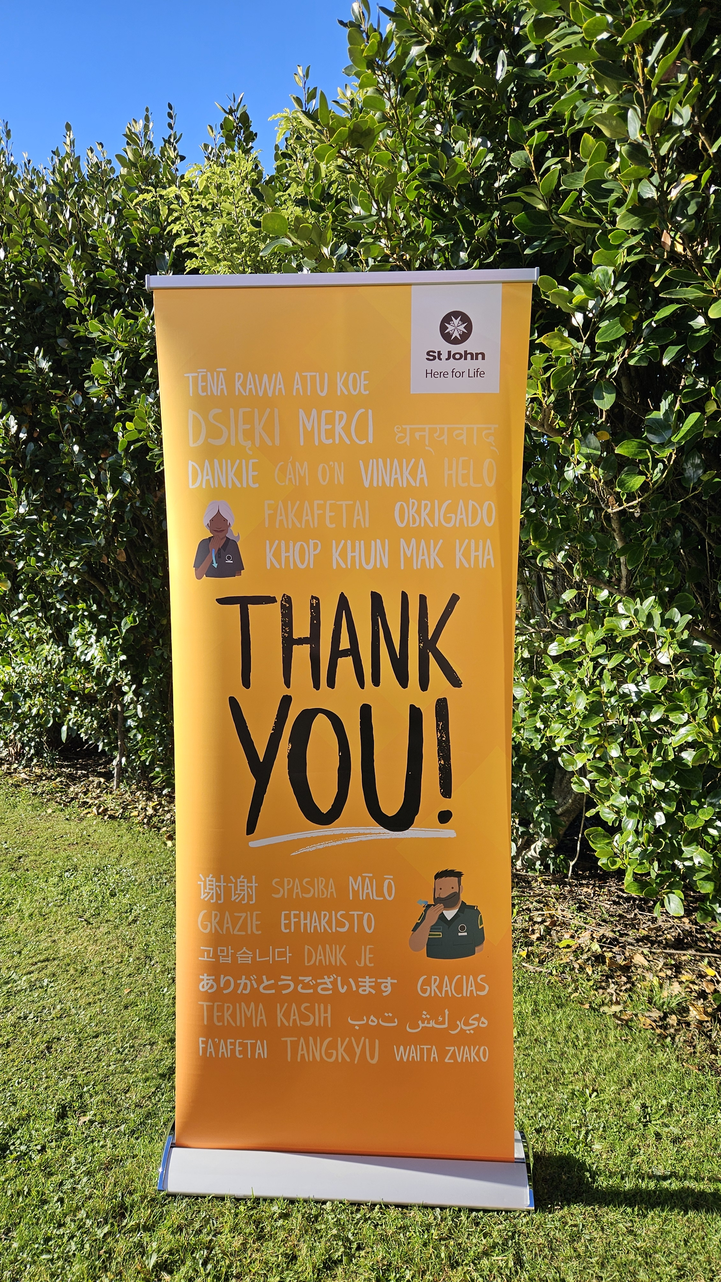
Any Pātai?
Questions?
Notes:
People can become educators.
This is a volunteer role
Free, free, free!

